Slide 1
Business Intelligence
8-1
Notes:
CLASSROOM OPENER
GREAT BUSINESS DECISIONS – Bill Inmon – The Father of the Data Warehouse
Bill Inmon, is recognized as the "father of the data warehouse" and co-creator of the "Corporate Information Factory." He has 35 years of experience in database technology management and data warehouse design. He is known globally for his seminars on developing data warehouses and has been a keynote speaker for every major computing association and many industry conferences, seminars, and tradeshows.
As an author, Bill has written about a variety of topics on the building, usage, and maintenance of the data warehouse and the Corporate Information Factory. He has written more than 650 articles, many of them have been published in major computer journals such as Datamation, ComputerWorld, DM Review and Byte Magazine. Bill currently publishes a free weekly newsletter for the Business Intelligence Network, and has been a major contributor since its inception. http://www.b-eye-network.com/home/

Slide 2
LEARNING OUTCOMES
Explain the relationship between Business Intelligence and a Data Warehouse
Data multi-dimensionality
Steps in BI
8-2
Notes:
A detailed review of the learning outcomes can be found at the end of the chapter in the textbook

Slide 3
Data Warehouse Fundamentals
Data warehouse – a logical collection of information – gathered from many different operational databases – that supports business analysis activities and decision-making tasks
8-3
Notes:
What is the primary difference between a database and data warehouse?
The primary difference between a database and a data warehouse is that a database stores information for a single application, whereas a data warehouse stores information from multiple databases, or multiple applications, and external information such as industry information
This enables cross-functional analysis, industry analysis, market analysis, etc., all from a single repository
Data warehouses support only analytical processing (OLAP)

Slide 4
Data Integration and the Extraction, Transformation, and Load (ETL) Process
https://www.dummies.com/programming/big-data/engineering/six-vendors-with-middleware-products-for-data-warehousing/

Slide 5
Multidimensional Analysis and Business Intelligence
Databases contain information in a series of two-dimensional tables
In a Business Intelligence, data is multidimensional:
It contains layers of columns and rows
Dimension – a particular attribute of information
8-5
Notes:
Each layer in a data warehouse or data mart represents information according to an additional dimension
Dimensions could include such things as:
Products
Promotions
Stores
Category
Region
Stock price
Date
Time
Weather
Why is the ability to look at information based on different dimensions critical to a businesses success?
Ans: The ability to look at information from different dimensions can add tremendous business insight
By slicing-and-dicing the information a business can uncover great unexpected insights

Slide 6
Representation of Data in DW
Dimensional Modeling
A retrieval-based system that supports high-volume query access
Star schema (Logical structure)
The most commonly used and the simplest style of dimensional modeling
Contain a fact table surrounded by and connected to several dimension tables

Slide 7
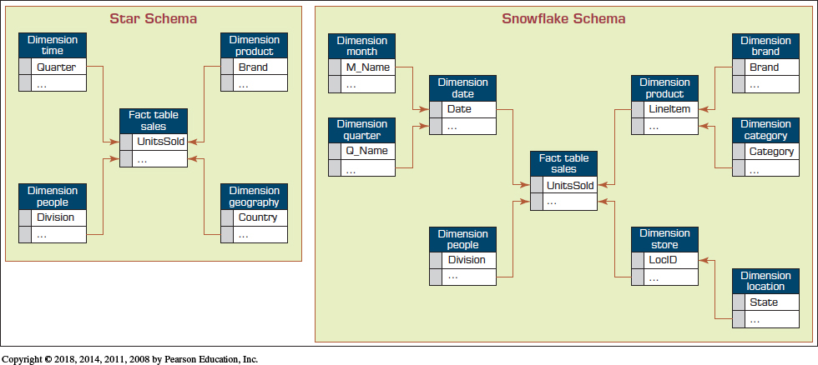
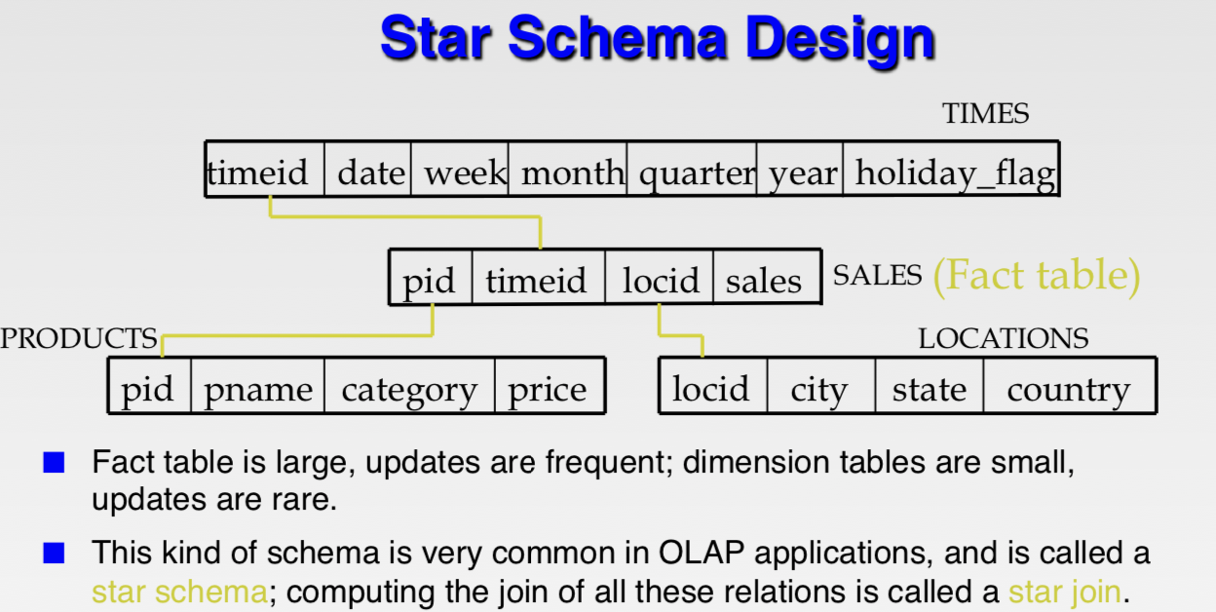
Star Schema versus Snowflake Schema

Slide 8
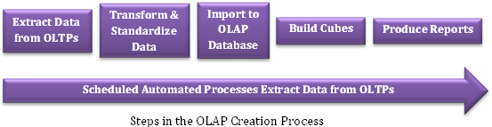
OLAP Creation Process
2 usual ways to get action on OLAP:
ROLAP: Relational OLAP, use SQL to query directly on relational tables.
MOLAP: Multidimensional OLAP, data aggregated as flat file called OLAP cube for fast slicing, dicing, roll-up, and drill-down operations using MDX (Multidimensional Expression).
In Excel:
Pivot table ~ MOLAP (deal with flat table)
Power Pivot ~ ROLAP (deal with relational tables)

Slide 9
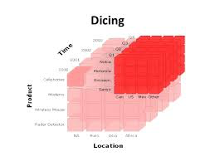
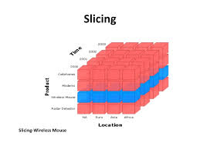
OLAP Operations
Slice - a subset of a multidimensional array
Slice on Year 2022 and Region North
Dice - a slice on more than two dimensions
Dice to see only Year 2022-2023, Products (A, B), Region(North, South)
Drill Down/(Roll) Up - navigating among levels of data ranging from the most summarized (up) to the most detailed (down)
Year → Drill down to Year/Quarter → Month
Year/Quarter → Roll up to Year
Pivot - used to change the dimensional orientation of a report or an ad hoc query-page display
Region on X, Time on Y, Product on Z-axis → Time, Product, Region

Slide 10
BUSINESS INTELLIGENCE
Business intelligence (BI) – applications and technologies used to gather, provide access to, and analyze data and information to support decision-making efforts
Paraphrase the challenges in business and challenges in war
Collecting information
Discerning patterns and meaning in the information
Responding to the resultant information
Notes:
An early reference to business intelligence occurs in Sun Tzu’s book The Art of War. Sun Tzu claims that to succeed in war, one should have full knowledge of one’s own strengths and weaknesses and full knowledge of the enemy’s strengths and weaknesses. Lack of either one might result in defeat.

Slide 11
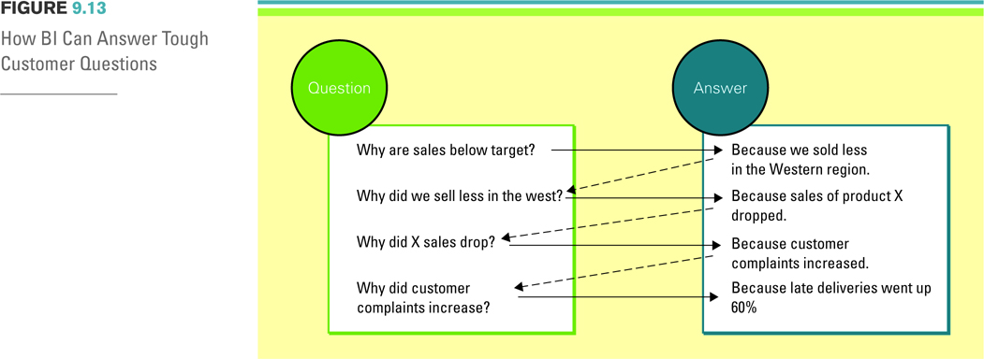
THE SOLUTION: BUSINESS INTELLIGENCE
BI Can Answer Tough Questions
Notes:
The figure displays how organizations using BI can find the root causes to problems and provide solutions simply by asking “Why?” The process is initiated by analyzing a global report, say of sales per quarter.
Every answer is followed by a new question, and users can drill deep down into a report to get to fundamental causes.
Once they have a clear understanding of root causes, they can take highly effective action.
Finding the answers to tough business questions by using data that is reliable, consistent, understandable, and easily manipulated allows a business to gain valuable insight into such things as:
Where the business has been. Historical perspective is always important in determining trends and patterns of behavior.
Where it is now. Current situations are critical to either modify if not acceptable or encourage if they are trending in the right direction.
And where it will be in the near future. Being able to predict with surety the direction of the company is critical to sound planning and to creating sound business strategies.

Slide 12
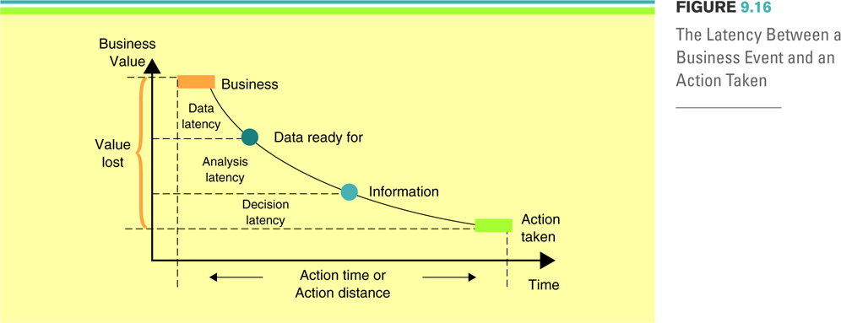
BI’s Operational Value
Richard Hackathorn’s graph demonstrating the value of operational BI
Notes:
Richard Hackathorn of Bolder Technologies developed an interesting graph to demonstrate the value of operational BI.
This Figure shows the three latencies that impact the speed of decision making.
These are data, analysis, and decision latencies.
Data latency is the time duration to make data ready for analysis (i.e., the time for extracting, transforming, and cleansing the data), and loading the data into the database. All this can take time depending on the state of the operational data to begin with.
Analysis latency is the time from which data are made available to the time when analysis is complete. Its length depends on the time it takes a business to do analysis. Usually, we think of this as the time it takes a human to do the analysis, but this can be decreased by the use of automated analytics that have thresholds. When the thresholds are exceeded, alerts or alarms can be issued to appropriate personnel, or they can cause exception processes to be initiated with no human intervention needed.
Decision latency is the time it takes a human to comprehend the analytic result and determine an appropriate action. This form of latency is very difficult to reduce. The ability to remove the decision-making process from the human and automate it will greatly reduce the overall decision latency. Many forward thinking companies are doing just that. For example, rather than send a high value customer a letter informing him of a bounced check (which takes days to get to the customer), an automated system can simply send an immediate email or voice message informing the customer of the problem

Slide 13
BI’S OPERATIONAL VALUE
Three latencies that impact the speed of decision making
Data latency - the time duration to make data ready for analysis
Analysis latency - the time from which data are made available to the time when analysis is complete
Decision latency - the time it takes a human to comprehend the analytic result and determine an appropriate action
Notes:
Richard Hackathorn of Bolder Technologies developed an interesting graph to demonstrate the value of operational BI.
This Figure shows the three latencies that impact the speed of decision making.
These are data, analysis, and decision latencies.
Data latency is the time duration to make data ready for analysis (i.e., the time for extracting, transforming, and cleansing the data), and loading the data into the database. All this can take time depending on the state of the operational data to begin with.
Analysis latency is the time from which data are made available to the time when analysis is complete. Its length depends on the time it takes a business to do analysis. Usually, we think of this as the time it takes a human to do the analysis, but this can be decreased by the use of automated analytics that have thresholds. When the thresholds are exceeded, alerts or alarms can be issued to appropriate personnel, or they can cause exception processes to be initiated with no human intervention needed.
Decision latency is the time it takes a human to comprehend the analytic result and determine an appropriate action. This form of latency is very difficult to reduce. The ability to remove the decision-making process from the human and automate it will greatly reduce the overall decision latency. Many forward thinking companies are doing just that. For example, rather than send a high value customer a letter informing him of a bounced check (which takes days to get to the customer), an automated system can simply send an immediate email or voice message informing the customer of the problem

Slide 14
Objective learning review
DW is subjected-oriented DB specially designed to support decision making without disrupting daily operations.
OLAP and BI are tools equipped to DW for analytics.

